Slide 1
My skimmer
by Quang Huynh

Slide 2
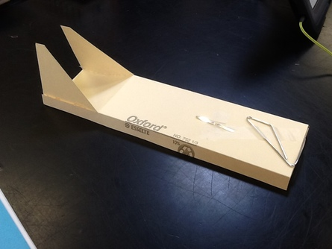
The back angle keeps the air trapped underneath.
The air scoop-channel gets air underneath, forcing the skimmer to go forward because of the air.
The fins keep the skimmer straight and not curve.
Aerodynamics is motion of the air, and how the air works.

Slide 3
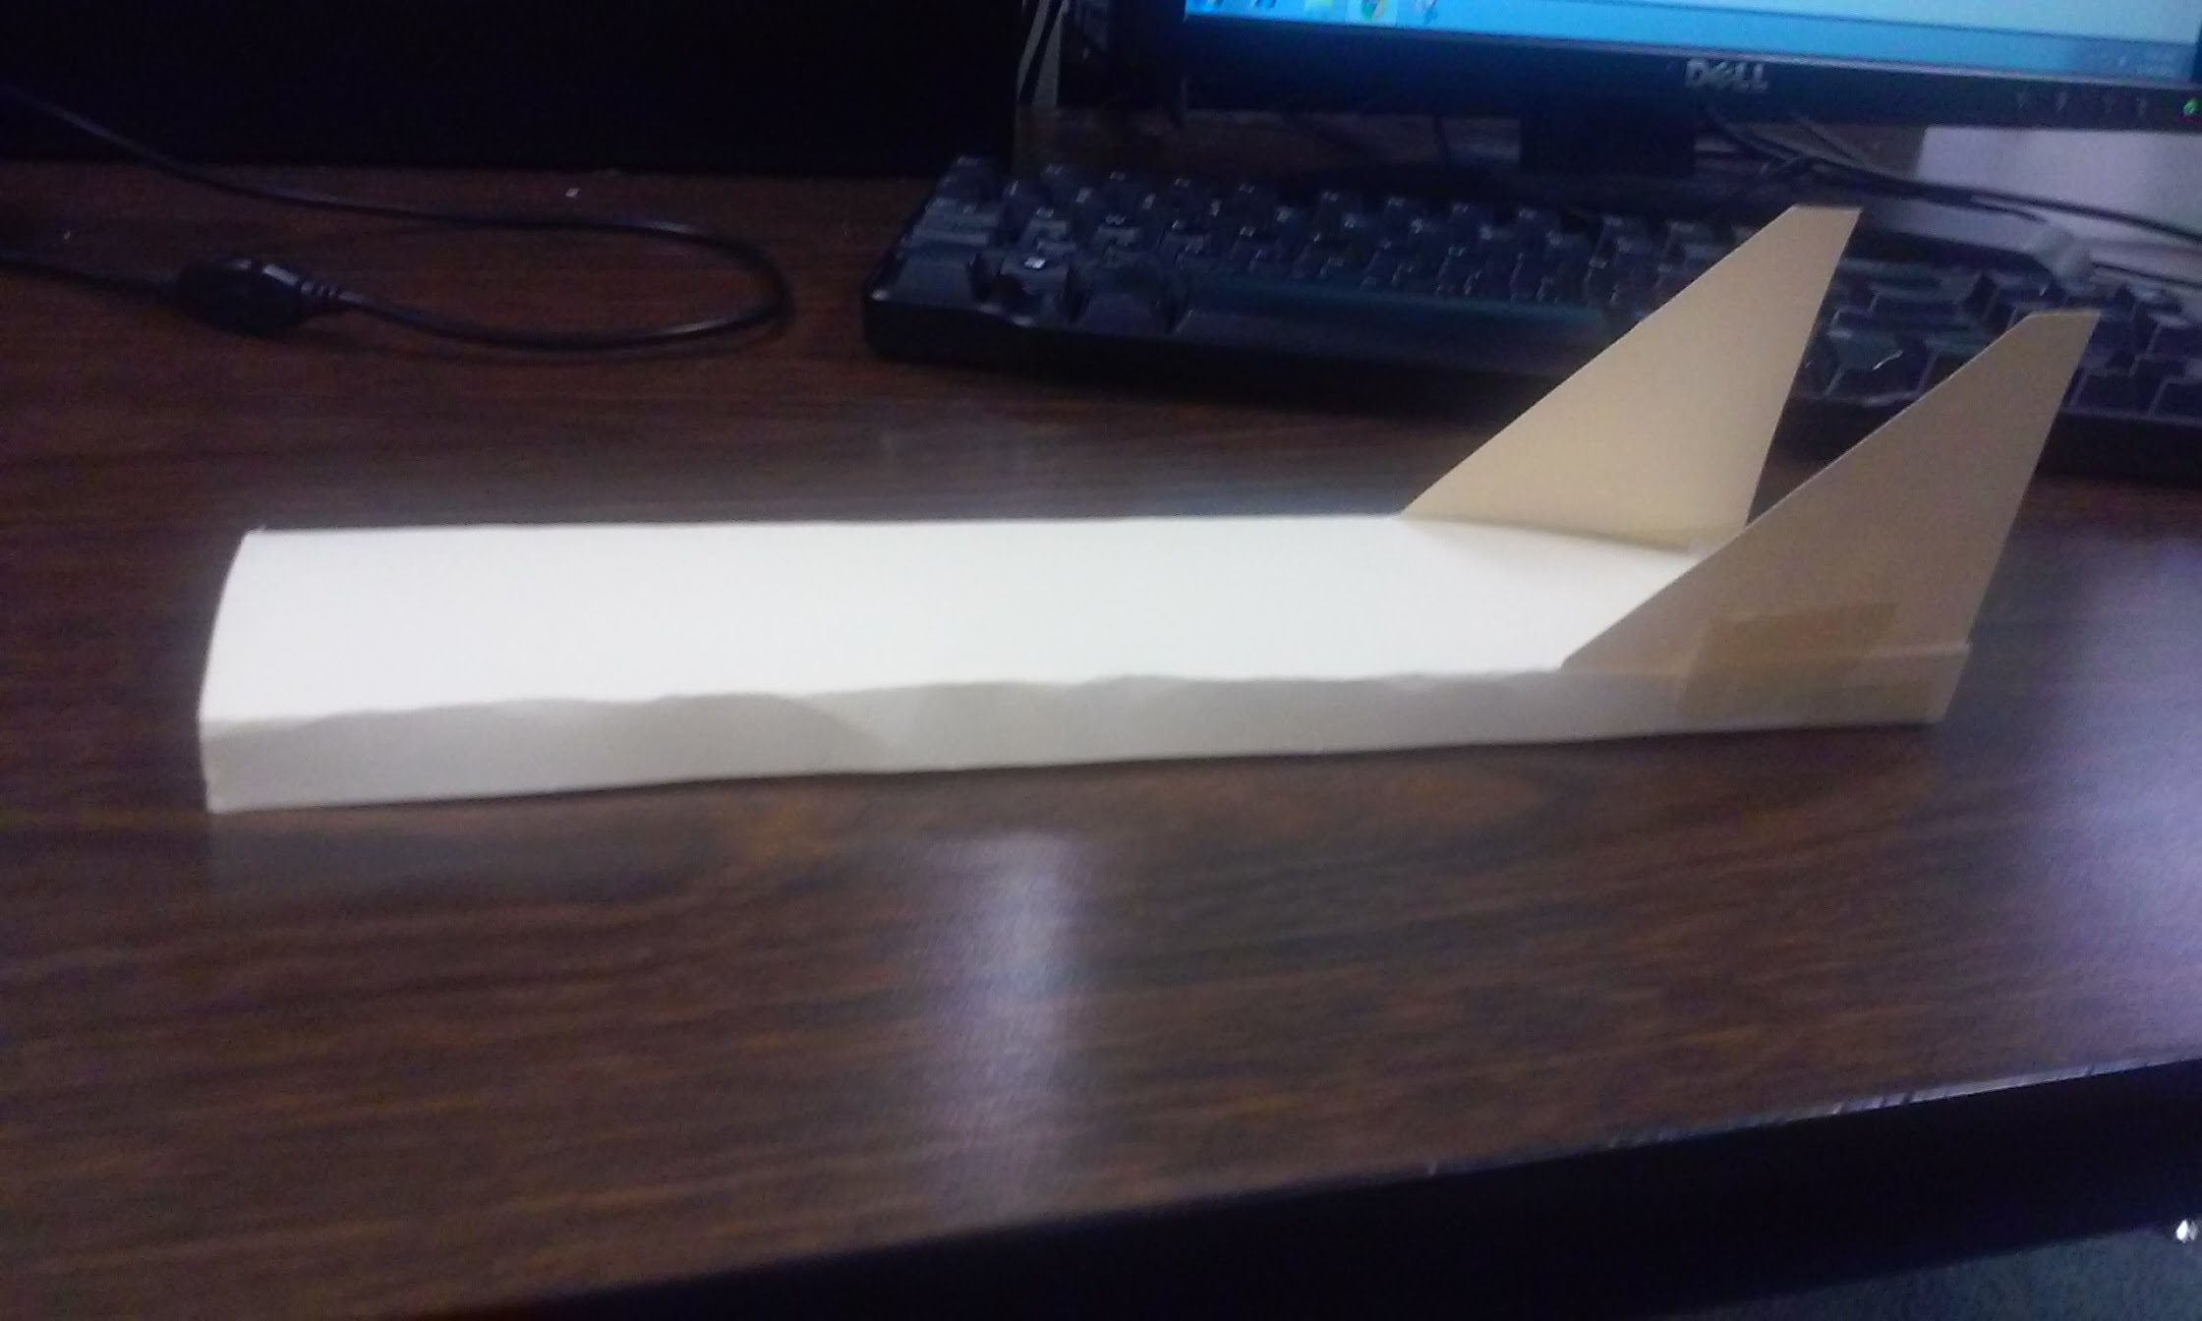
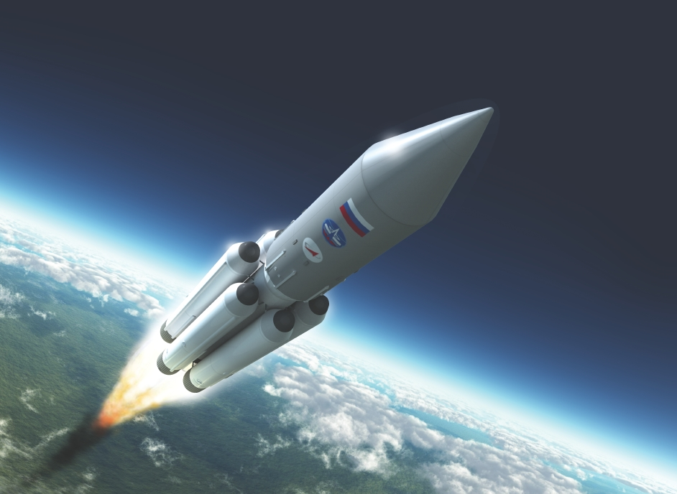
Newton’s 3rd Law
For every action, there is an equal and opposite reaction.
Pulls back and cuts drag, moving the skimmer forward
Rocket fires upward, because the boosters are firing downward, moving the rocket upward.

Slide 4
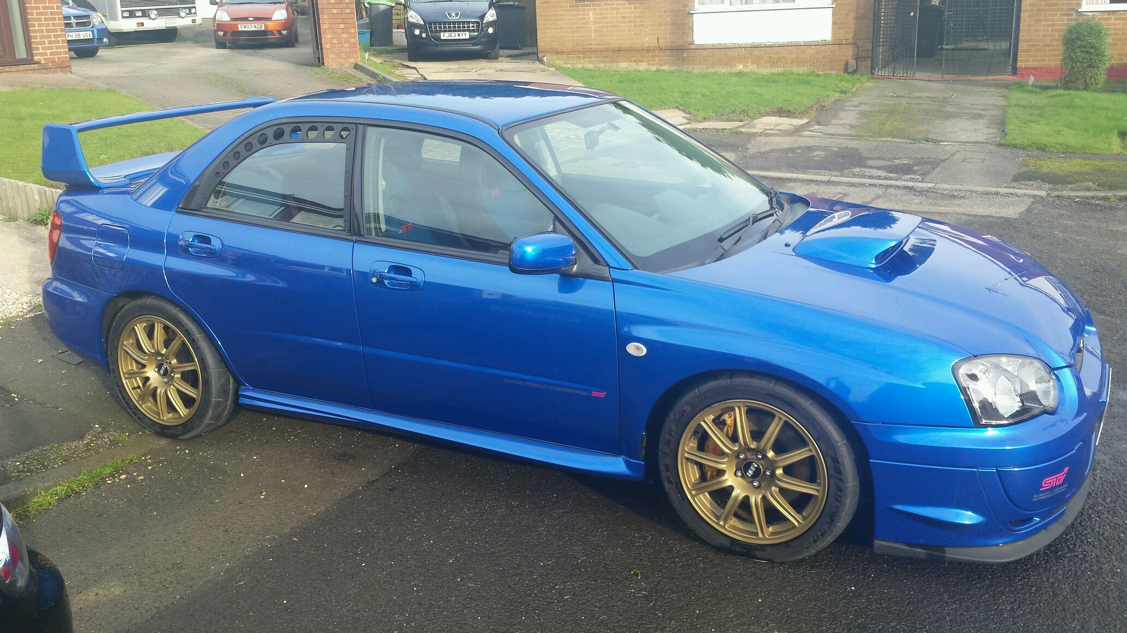



Aerodynamic Surfaces
Spoiler
The spoiler generates drag, increasing
Air scoop
Allows a flow of air to enter the engine section.
Side skirts
Prevents airflow from making its way underneath the chassis from a vehicle's side, and can streamline.

